Slide 1
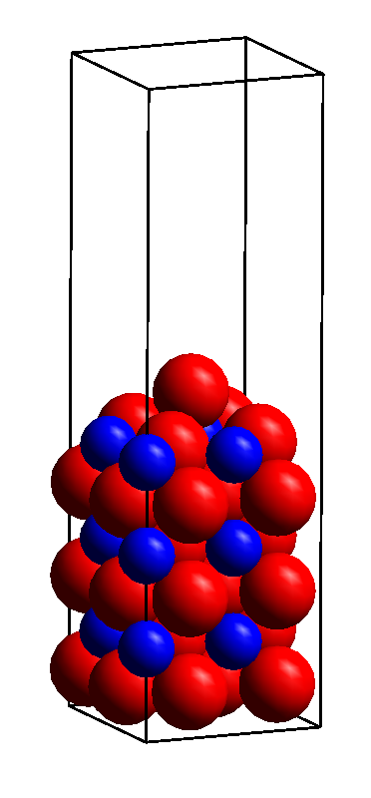
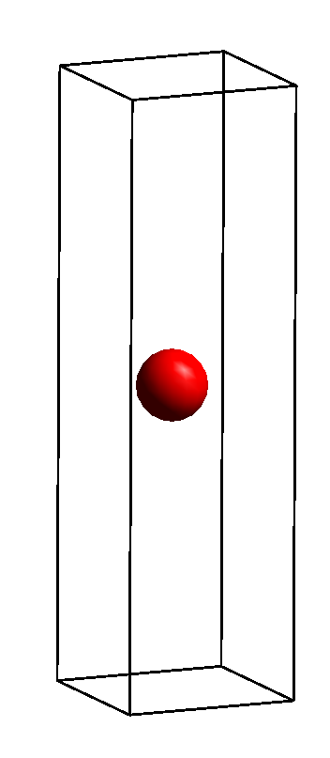
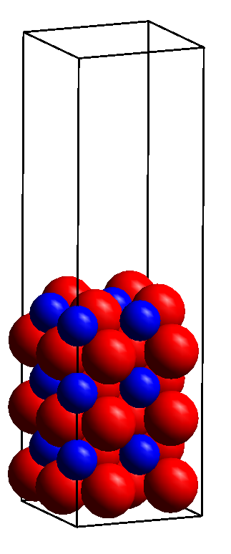
Charge Density Difference example
Perovskite LaCoO₃ (100) + O example, M. Penninger
O
O
Charge Density Difference
CHGCAR
Surface + adsorbate CHGCAR
Surface CHGCAR
Adsorbate CHGCAR
Calculate CHGCARs using identical parameters, supercells, and atom locations
Differences constructed using ….

Slide 2
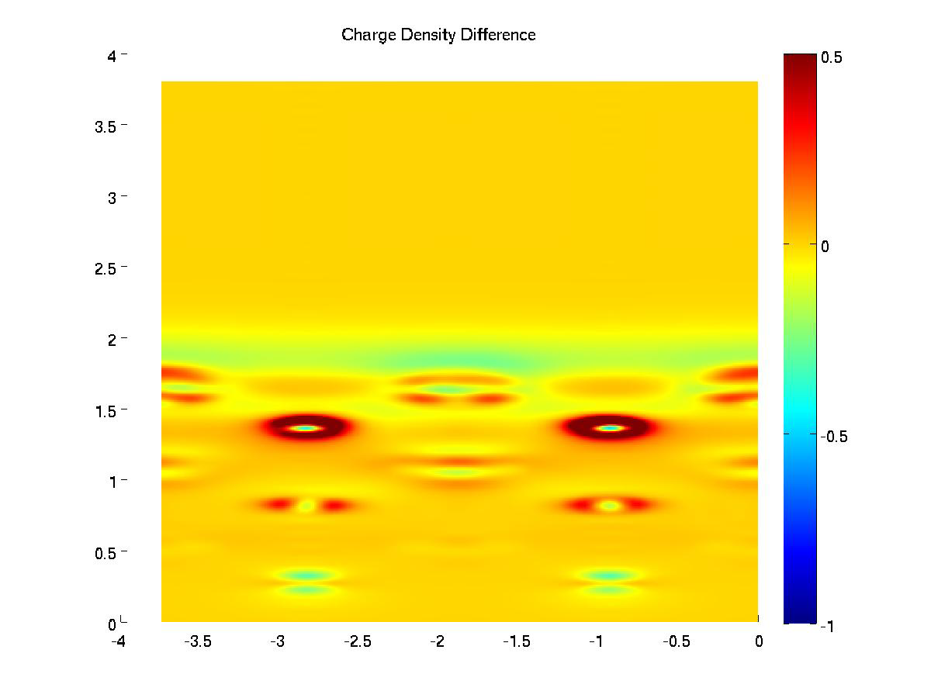
Charge Density Difference Slices
O
(001)
LaO
CoO₂
LaO
CoO₂
LaO
CoO₂
(010)

Slide 3
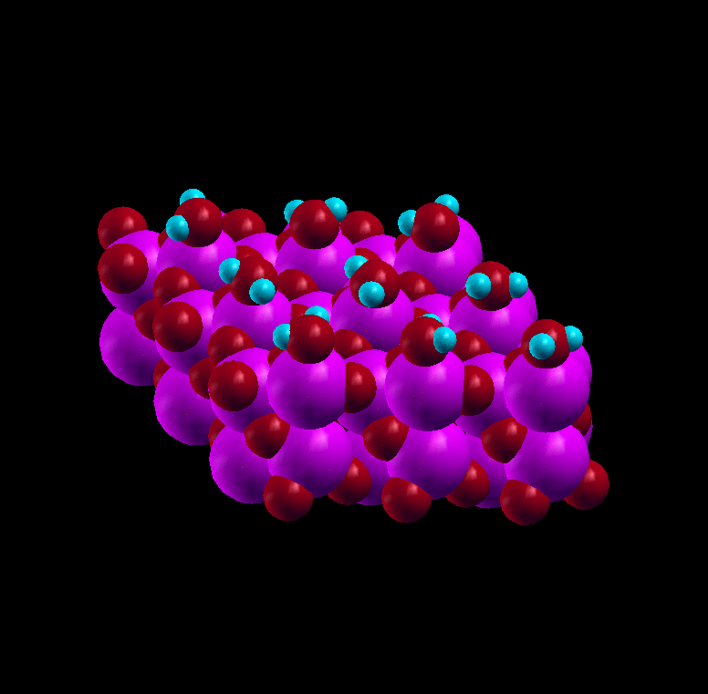
Molecular Dynamics example
1 ML H₂O
Al₂O₃ (0001)

Slide 4
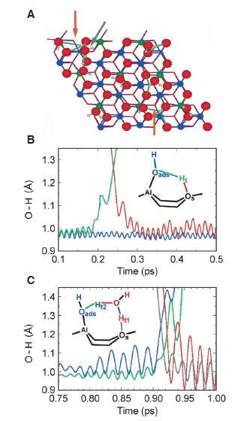
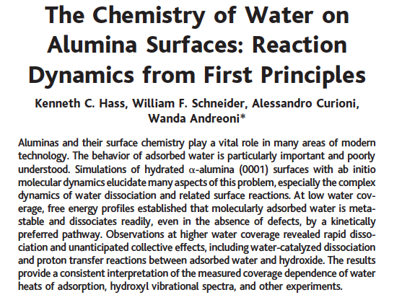
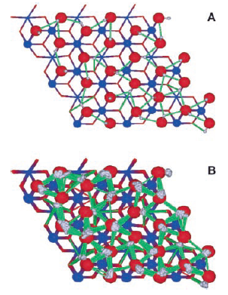

H₂O Dissociation Dynamics on Al₂O₃ (0001)
Initial dissociations
Fully hydroxylated

